Slide 1

Today’s Agenda
Registers
Shift registers
Serial adders

Slide 2
Registers
Group of D-F/Fs
Synchronized (One CLK)
Store data
I₀
D
Q
A₀
R
I₁
D
Q
A₁
R
I₂
D
Q
A₂
R
I₃
D
Q
A₃
CLK
R
Reset

Slide 3
Registers
I₀
D
Q
A₀
CLK
I₃
R
I₂
I₁
A₁
D
Q
I₁
R
I₀
A₃
I₂
D
Q
A₂
A₂
R
A₁
I₃
D
Q
A₃
A₀
CLK
R
Reset

Slide 4
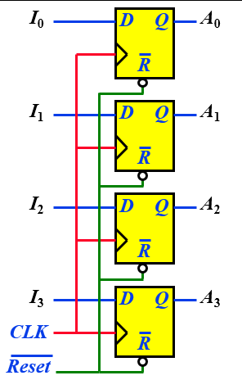

Register with Parallel Load
Requirement:
  Retain/Store old data (when ever desired)
  Control Loading the Register with new data
First Solution:
  If the contents of the register must be left unchanged, the inputs must be held constant
  The data bus driving the register would be unavailable for other traffic

Slide 5


Register with Parallel Load
LD | Q(t+1)
0 | Q(t)
1 | D
  Control the operation of register with D Inputs
  Use MUX and circulate ‘Old Data’
MUX
I₀
I₁
Y
D
Q
A₀
I₀
S
MUX
I₀
I₁
Y
D
Q
A₁
I₁
S
MUX
I₀
I₁
Y
D
Q
A₂
I₂
S
MUX
I₀
I₁
Y
D
Q
A₃
I₃
S
Load
CLK

Slide 6
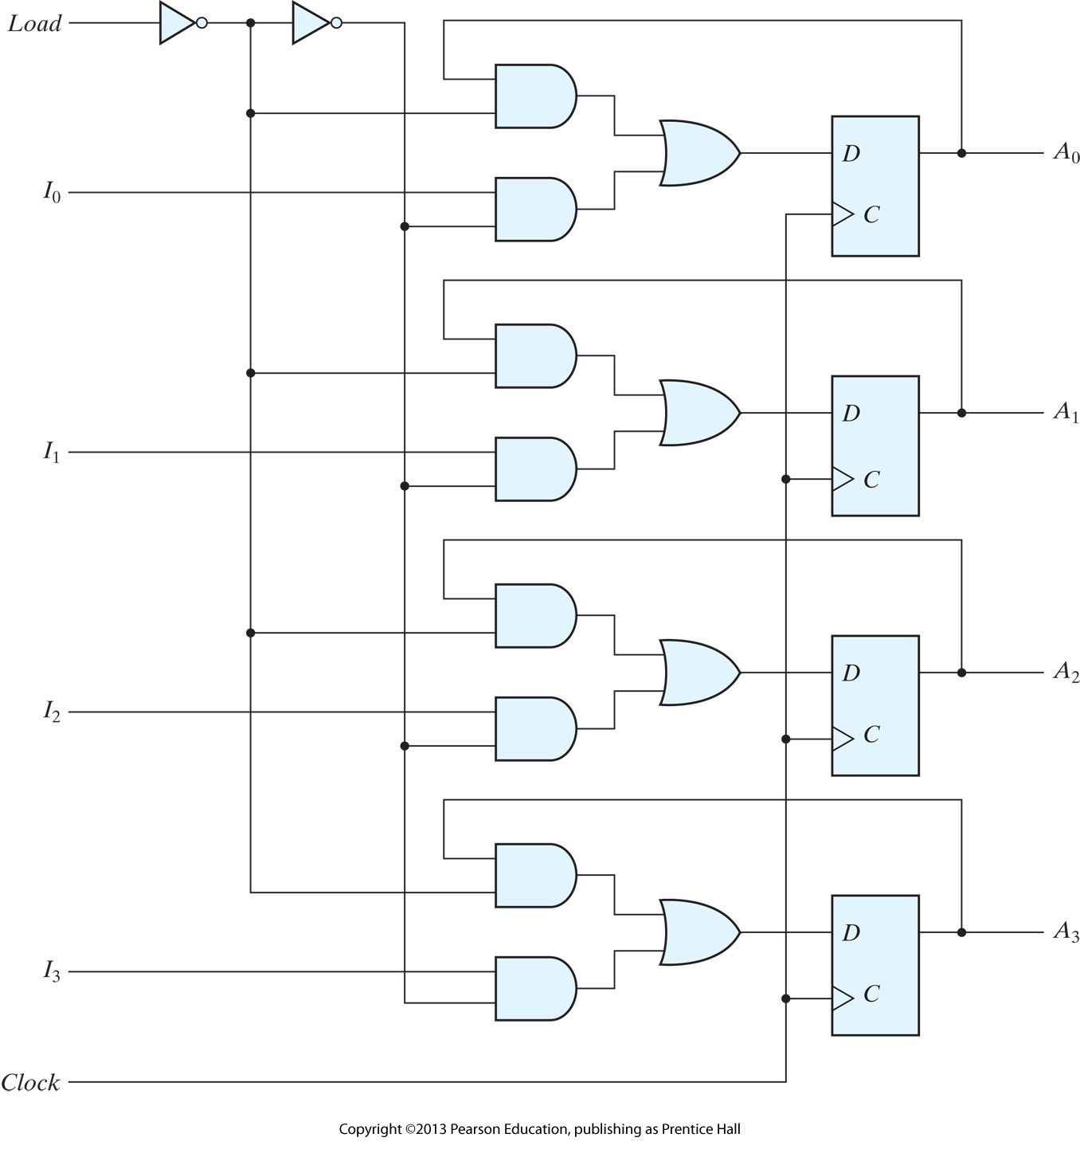
Register with Parallel Load

Slide 7
Shift Registers
What are they?
  A register capable of shifting the binary info. held in each cell to its neighboring cell, in a selected direction
Construction:
  Consists of a chain of F/Fs in cascade
  All F/Fs receive common CLK pulses to activate shift
Serial
Input
SI
SO
D
Q
D
Q
D
Q
D
Q
Serial
Output
CLK

Slide 8
Shift Registers
Q₃
Q₂
Q₁
Q₀
SI
D
Q
D
Q
D
Q
D
Q
SO
CLK
CLK
SI
Q₃
Q₂
Q₁
Q₀

Slide 9
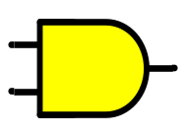
Serial Transfer Transfer
Scenario:
  Source Register (A) holds 1 (4-bit) value
  Which needs to be ‘copied’ in Destination Register (B)
  ‘Copied’ means Transfer into ‘B’ and Retain in ‘A’
For Transfer (A → B):
  Connect O/p of ‘A’ into I/p of ‘B’
  Synchronize both Registers with same Clock
  Clock can be ‘anded’ with Shift Control I/p
For Retain (A → A):
  Recirculate the O/p of ‘A’ as I/p of same register
SI
SO
SI
Shift Register A
Shift Register B
Clock
CLK
CLK
Shift
Control

Slide 10
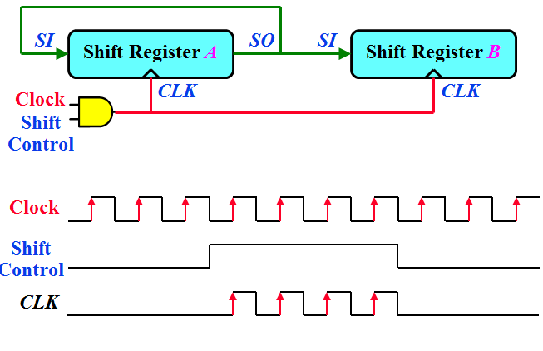
Serial Transfer
Data transfer one bit at a time
Data loopback for register A
Time
initial
T1
T2
T3
T4
Reg A
1011
1101
1110
0111
1011
Reg B
0010
1001
1100
0110
1011

Slide 11
Serial Adder
Scenario:
  Register A holds ‘Augend’
  Register B holds ‘Addend’
  Contents of A and B needs to be added serially
Design:
  Have a Full Adder (FA) (x + y + C_{in})
  Connect O/ps of A and B into FA
  What to do with Sum (S) and Carry (C) O/ps?
Shift Register A
FA
x
y
z
S
C
Shift Register B

Slide 12
Serial Adder
Carry (C) O/p:
  How to ‘feedback’ previous carry as next?
  C should also be synchronized together with Regs. A & B
  Remember, every component is synchronized with Clock
  So if somehow we manage to ‘attach’ C with Clock, it will get synchronized with clock or with Reg. A & B
  We can not connect Clock with FA (Combinational cct.)
  Solution: Add a F/F (Say D-type) to store C
Shift Register A
FA
x
y
z
S
C
Shift Register B
Q
D
CLR
Clear

Slide 13
Serial Adder
Sum (S) O/p:
  Result of summation can be stored in another Register (say D)
Shift Register A
FA
x
y
z
S
C
Shift Register D
Shift Register B
Q
D
CLR
Clear

Slide 14
Serial Adder
Sum (S) O/p:
  In case, contents of one of the input Registers (‘A’ or ‘B’) are no more required to be preserved
  ‘A’ can also be used to retain the result of Summation (previous data over-written)
  Re-circulate ‘S’ into ‘A’
SI
Shift Register A
FA
x
y
z
S
C
Shift Register B
Q
D
CLR
Clear

Slide 15
Serial Adder (First Form)
Adding Clock controlled with ‘ Shift I/p’
Shift
Control
SI
Shift Register A
FA
x
y
z
S
C
Shift Register B
CLK
With every clock pulse, one bit each from ‘A’ and ‘B’ goes into FA. Previous carry stored in F/F also gets in.
Q
D
CLR
Clear

Slide 16
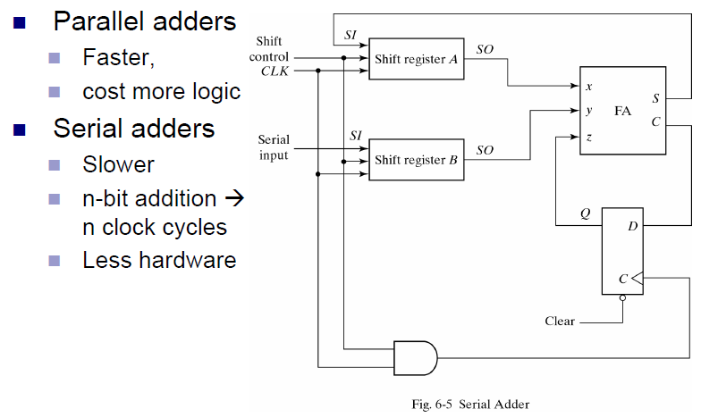
Serial Addition

Slide 17
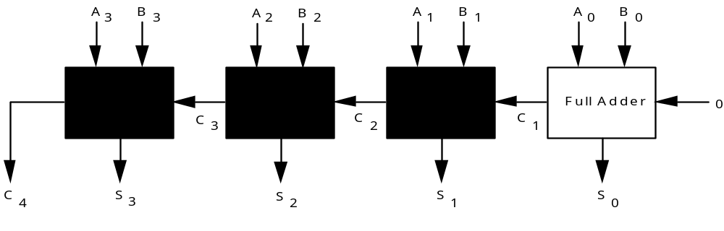
4-Bit Adder
Chain single-bit adders together.
C 1 1 1 0
A 0 1 0 1
B 0 1 1 1
S 1 1 0 0

